Slide 1
Purdue School of Aviation and Transportation Technology
“ Building resilience in aviation:
The role of crisis management plan in a dynamic environment”
Dr. Dimitrios Ziakkas
Assistant Professor SATT
Nicosia 14, June 2022, 0230 PM

Slide 2
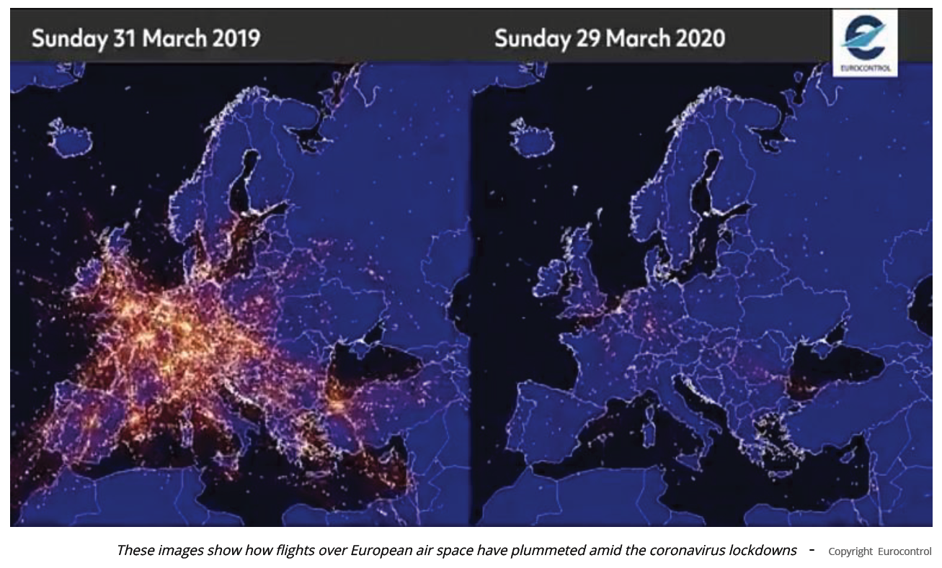
“ Building resilience in aviation: The role of crisis management plan in a dynamic environment”
https://www.euronews.com/2020/04/09/coronavirus-in-europe-see-how-flights-have-plummeted-over-the-continent-amid-covid-19-lock
Notes:
This Figure is part of the function network for adaptation of crisis response in the Swedish Civil Response of the Asian Tsunami of 2004 and the Israel-Lebanon War of 2006 (see Lundberg & Rankin, 2013). Over the top dividing line, two background functions are described. Both functions output “positive attitudes” (to taking improvised roles), an important pre-requisite for self-assigning and taking improvised roles.
Four instantiations of the function network are visualized in Figure 2 as coloured lines. They were derived from stories presented by crisis response personnel describing their experiences (see Lundberg & Rankin, 2013). Looking at the lines going through the matrix, it is immediately clear from a visual inspection that there are minor differences in paths between the orange and brownish lines. To inspect the significance of the differences, the analyst may follow both lines and identify functions that are activated in one instantiation but
not in the other. In this case, the difference lies in the execution of the “survey competences” function. The
output from that function is “more optimal role assignments”. This is also reflected in the summary rows for both instantiations below the lower dividing lines. In the summary row, the “more optimal role assignments” are labelled as potentially increasing resilience in terms of increased margin of operations. Figure 2 is part of the function network for adaptation of crisis response in the Swedish Civil Response of the Asian Tsunami of 2004 and the Israel-Lebanon War of 2006 (see Lundberg & Rankin, 2013). Over the top dividing line, two background functions are described. Both functions output “positive attitudes” (to taking improvised roles), an important pre-requisite for self-assigning and taking improvised roles.
Four instantiations of the function network are visualized in Figure 2 as coloured lines. They were derived from stories presented by crisis response personnel describing their experiences (see Lundberg & Rankin, 2013). Looking at the lines going through the matrix, it is immediately clear from a visual inspection that there are minor differences in paths between the orange and brownish lines. To inspect the significance of the differences, the analyst may follow both lines and identify functions that are activated in one instantiation but
not in the other. In this case, the difference lies in the execution of the “survey competences” function. The
output from that function is “more optimal role assignments”. This is also reflected in the summary rows for both instantiations below the lower dividing lines. In the summary row, the “more optimal role assignments” are labelled as potentially increasing resilience in terms of increased margin of operations. Figure 2 is part of the function network for adaptation of crisis response in the Swedish Civil Response of the Asian Tsunami of 2004 and the Israel-Lebanon War of 2006 (see Lundberg & Rankin, 2013). Over the top dividing line, two background functions are described. Both functions output “positive attitudes” (to taking improvised roles), an important pre-requisite for self-assigning and taking improvised roles.
Four instantiations of the function network are visualized in Figure 2 as coloured lines. They were derived from stories presented by crisis response personnel describing their experiences (see Lundberg & Rankin, 2013). Looking at the lines going through the matrix, it is immediately clear from a visual inspection that there are role” column, identifying it is as the function that may cause this situation. Looking in that column, the analyst can see that “green line” instantiations will execute that function. The analysis thus reveals interactions between instantiations. In terms of resilience, it is represented in the row for the “green line” as “inflexibility by disabling role survey and manager assignments.”

Slide 3
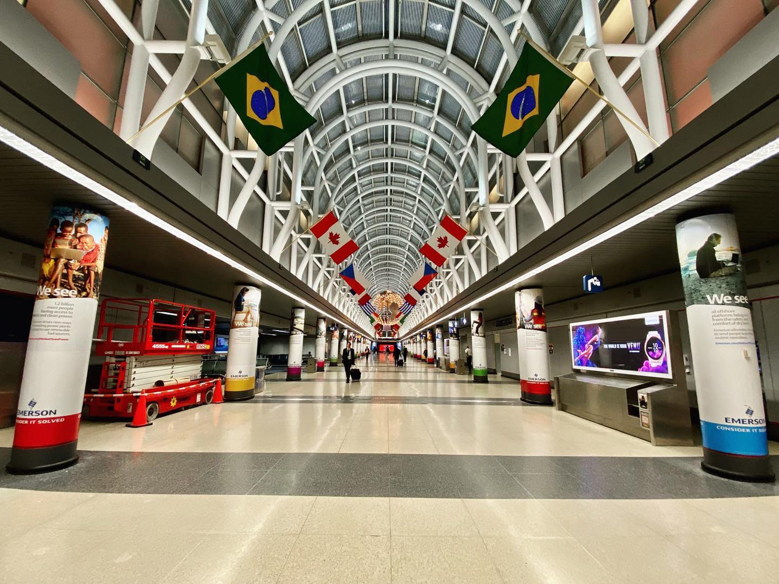
“ Building resilience in aviation: The role of crisis management plan in a dynamic environment”
Inside Chicago's O'Hare International Airport.
Source: Ryan Ewing

Slide 4
“ Building resilience in aviation: The role of crisis management plan in a dynamic environment”

Slide 5
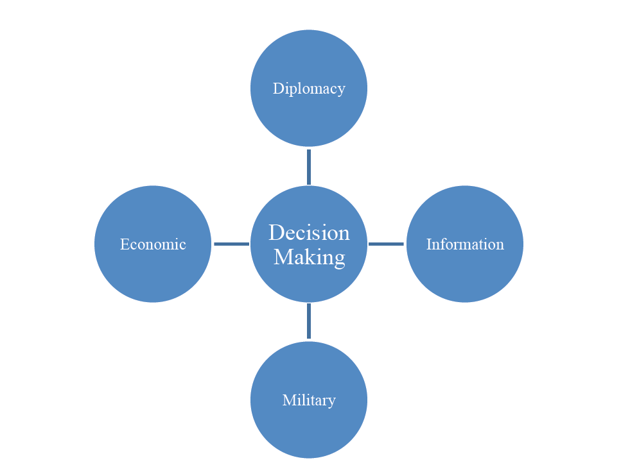
“ Building resilience in aviation: The role of crisis management plan in a dynamic environment”
The DIME model captures the main elements of national power (Diplomacy, Information, Military, Economics).
Notes:
DIME (as well as its derivatives DIMEFIL and MIDLIFE) is a useful construct to consider the national-level impacts of the ongoing COVID-19 crisis and to consider what those impacts mean to our future as a nation. For example, the U.S. State Department has dramatically scaled back operations, which impacts everything from visa applications and liaison work to immigration. Passport services are almost entirely shut down, except for extreme situations like a “qualified life-or-death emergency.” Moreover, for the first time in its history, the entire Peace Corps has been recalled and is shutting down its overseas activities, and USAID has shifted much of its effort to fighting the virus. The world’s foremost source of information, the internet, is also being negatively impacted. Despite the fact that COVID-19 is largely a medical and political problem, the military does have a large role to play. The National Guard, reserves, and/or active duty force might be called upon to provide disaster support to civil authorities (DSCA), provide medical assistance, maintain order, and deliver much-needed supplies. In international relations theory, there is a concept called the security dilemma, which in simple terms is the belief that the steps that one country takes to make itself more secure inevitably make other countries feel less secure, which in turn causes other countries to raise their level of security — and on and on.

Slide 6
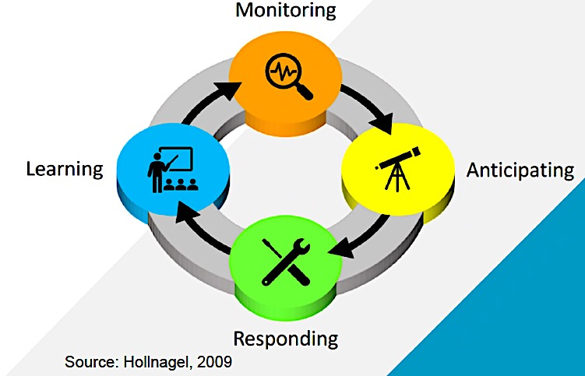
“ Building resilience in aviation: The role of crisis management plan in a dynamic environment”
What is resilience?

Slide 7
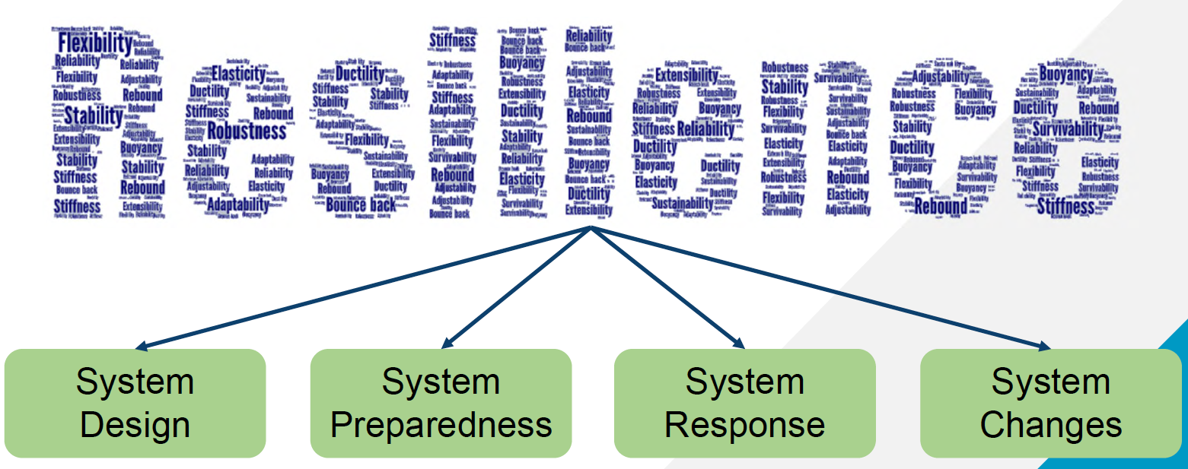
“ Building resilience in aviation: The role of crisis management plan in a dynamic environment”
Resilience is a concept
Source: Adapted from Hollnagel, 2009

Slide 8
“ Building resilience in aviation: The role of crisis management plan in a dynamic environment”
System Preparedness

Slide 9
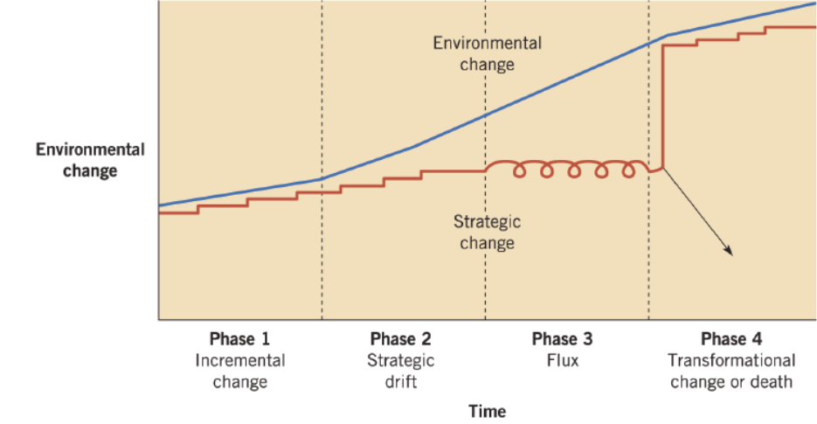
“ Building resilience in aviation: The role of crisis management plan in a dynamic environment”
Long-term / unexpected distractions
Pandemic –COVID19
Johnson, G., Scholes, R., & Whittington, R. (2005). Exploring corporate strategy (7th ed.). Harlow: Pearson Education.

Slide 10
“ Building resilience in aviation: The role of crisis management plan in a dynamic environment”
System Response

Slide 11
“ Building resilience in aviation:
The role of crisis management plan in a dynamic environment”
Crisis Management Plan
Managing the COVID-19 crisis has turned up to be a colossal test to national governments.
When faced with a crisis, policymakers have four challenging crucial tasks:
Sense-making (understanding a crisis);
Making critical decisions and solving the immediate problems;
Communicate effectively;
Devising ‘exit strategies’ to end the crisis (Boin, Lodge and Luesink, 2020, p. 190).
However, ‘creeping’ characteristics of the pandemic posed novel and complex challenges, even to those policy-makers well-versed in the management of ‘acute’ crises, such as plane crashes or natural disasters.
(Boin, Lodge and Luesink, 2020, p. 190)
Notes:
Even though initially the responses to the public health crisis were disarticulated, national (not to mention local) solutions and unilateral remedies, rapidly mechanisms of European integration were brought to the fore and established patters of governance in the EU drew attention to solutions at the supranational level. Managing the COVID-19 crisis has turned up to be a colossal test to national governments.

Slide 12
“ Building resilience in aviation:
The role of crisis management plan in a dynamic environment”
Crisis Response Mechanism
Crisis response mechanism at the EU level emerged in the early 2000s, triggered by several dramatic events:
9/11 attacks (2001),
the terrorist attacks in Madrid (2004) and in London (2005),
Tsunami in the Indian Ocean (2004) and
Eyjafallajokull (2010)
In 2006, the Council adopted the emergency and crisis coordination arrangements (CAA), a platform for exchanging information and coordinating action between member states in case of a major crisis.
On 25 June 2013, the CAA was substituted by the integrated political crisis response arrangements (IPCR), which added flexibility and scalability to the existing resources, structures and capabilities.
On 28 January 2020, the Croatian Presidency of the Council activated the IPCR in information sharing mode (European Council/Council of the European Union, n.d.).
Notes:
For example, the idea of creating a crisis response mechanism at the EU level emerged in the early 2000s, triggered by several dramatic events, including the 9/11 attacks (2001), the terrorist attacks in Madrid (2004) and in London (2005) and the tsunami in the Indian Ocean (2004). As a result, in 2006, the Council adopted the emergency and crisis coordination arrangements (CAA), a platform for exchanging information and coordinating action between member states in case of a major crisis. On 25 June 2013, the CAA was substituted by the integrated political crisis response arrangements (IPCR), which added flexibility and scalability to the existing resources, structures and capabilities.12 On 28 January 2020, the Croatian Presidency of the Council activated the IPCR in information sharing mode (European Council/Council of the European Union, n.d.).
The EU also experienced several previous health crises, such as the BSE epidemic in the early 1990s, the SARS outbreak in 2003 and the 2009 H1N1 influenza pandemic and learned from the shortcomings of its response, namely by adjusting its crisis management structures and procedures.

Slide 13
“ Building resilience in aviation:
The role of crisis management plan in a dynamic environment”
COVID 19 in EU - Sense-making (understanding a crisis);
Early stages of the pandemic: EU institutions missed the opportunity to set the tone of the response.
Several factors explain the ‘invisibility’ of the supranational level:
The EU has limited competences in public health policy;
at the outset of the crisis there was very limited knowledge of the disease and the information regarding the spread and the consequences of the virus was controlled by Chinese authorities;
previous public health crises (such as SARS or H1N1 virus) have turned out to be much less serious in Europe than what was initially anticipated, which might account for an underestimation of the gravity of the novel coronavirus (even by the WHO).
Regardless the reasons, the early ‘light touch’ response was indicative of weaknesses in the EU crisis management capacity, particularly as regarding preparedness.
Notes:
The tracing of the events suggests that, at the early stages of the pandemic, EU institutions missed the opportunity to set the tone of the response. It was not that EU institutions (particularly the Commission) were absent. But the problem was initially handled by the technical structures. Several factors explain the ‘invisibility’ of the supranational level. The EU has limited competences in public health policy; at the outset of the crisis there was very limited knowledge of the disease and the information regarding the spread and the consequences of the virus was controlled by Chinese authorities; previous public health crises (such as SARS or H1N1 virus) have turned out to be much less serious in Europe than what was initially anticipated, which might account for an underestimation of the gravity of the novel coronavirus (even by the WHO). Regardless the reasons, the early ‘light touch’ response was indicative of weaknesses in the EU crisis management capacity, particularly as regarding preparedness.

Slide 14
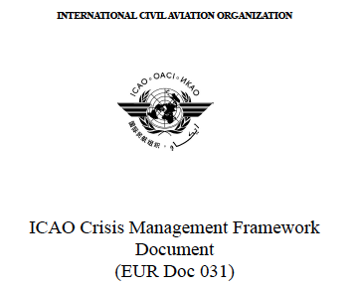
“ Building resilience in aviation:
The role of crisis management plan in a dynamic environment”
Making critical decisions and solving the immediate problems;
COVID-19 crisis has exposed a number of vulnerabilities in the EU and its Member States (…) Preparedness and prevention, early warning systems and coordination structures were clearly under strain, thus underlining the need for more ambitious crisis management for large- scale emergencies at EU level.
(European Commission, 2020e, p. 5, emphasis in the original)
2.3.3.4 In times of crisis, when impact of the network involves several states, an appropriate coordination mechanism should be established to facilitate information exchange involving the relevant State Focal Points. This will assist states in the crisis response measures, and provide them with relevant information to ensure harmonised decision making. (Doc 031)

Slide 15
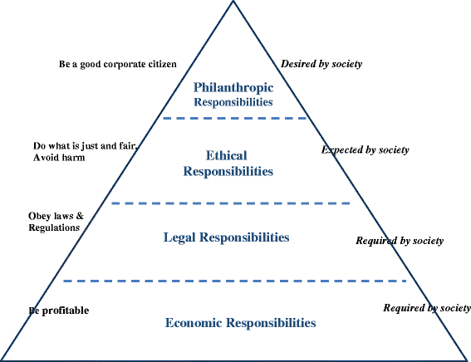
“ Building resilience in aviation: The role of crisis management plan in a dynamic environment”
Making critical decisions and solving the immediate problems;
Carroll’s pyramid of CSR, 2016
Cultural Iceberg Model, Edward T. Hall, 1970

Slide 16
“ Building resilience in aviation:
The role of crisis management plan in a dynamic environment”
Crisis Response Mechanism - Communicate effectively;
Have the European airlines communicated correctly according to the Situational Crisis Communication Theory?
What is the preferred communication channel for disseminating the crisis response strategy in the airline industry?
Defining the starting point of the COVID-19 crisis – The role of EU
Notes:
Situational Crisis Communication Theory (SCCT,), is a theory in the field of crisis communication. It suggests that crisis managers should match strategic crisis responses to the level of crisis responsibility and reputational threat posed by a crisis.^{[1]} SCCT was proposed by W. Timothy Coombs in 2007.
According to SCCT, evaluating the crisis type, crisis history and prior relationship reputation will help crisis managers predict the level of reputational threat of an organization and how that organization's publics will perceive the crisis and attribute crisis responsibility. Thus SCCT can be applied in an organization's crisis management.
Three types of crises have been identified by Coombs: the victim cluster, the accidental cluster, and the intentional cluster.^{[2]}
Coombs created his experimentally based SCCT to give communicators scientific evidence to guide their decisions, essentially stating that the actions an organization takes post-crisis depend on the crisis situation. "SCCT identifies how key facets of the crisis situation influence attributions about the crisis and the reputations held by stakeholders. In turn, understanding how stakeholders will respond to the crisis informs the post-crisis communication".^{[3]}
Coombs would later expand his work with SCCT through reflections of meta-analysis

Slide 17
“ Building resilience in aviation:
The role of crisis management plan in a dynamic environment”
Crisis Response Mechanism - Communicate effectively;
On January 25, 2020, two airlines—Aeroflot and Finnair—posted their first crisis-related messages:
Aerflot: “Information for passengers flying to/from China between 24 January and 7 February. Due to the virus pandemic in China, Aeroflot is offering passengers booked for flights to/from Chinese destinations to change their flight dates or return tickets” (Facebook, January 25, 2020).
Finnair: “Coronavirus update: We have updated our policy regarding the crew’s possibility to wear masks when working on our flights, in line with the recommendation from Chinese authorities, who recommend that people in direct customer contact wear masks as a precaution” (Facebook, January 25, 2020).
In contrast to Aeroflot and Finnair, EasyJet was the last to post its first crisis-related message in mid-March 2020.

Slide 18
“ Building resilience in aviation:
The role of crisis management plan in a dynamic environment”
Crisis Communication
Best practices to safeguard a company’s reputation in the event of an aviation crisis are as follows:
Communicate the basic facts about the crisis first, within an hour of the first signs of a crisis;
Emphasize instructing and adjusting information strategies;
Increase communication frequency during a crisis; and
Determine the appropriate crisis communication channels for addressing specific stakeholder groups.

Slide 19
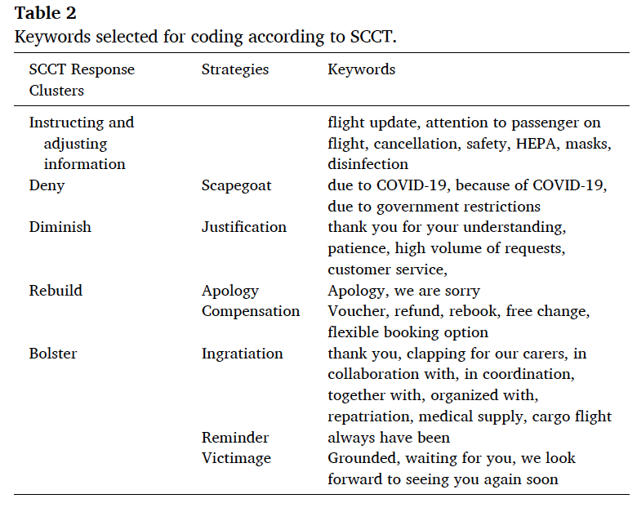
“ Building resilience in aviation:
The role of crisis management plan in a dynamic environment”
Crisis Communication
Source: Stephanie Scheiwiller, Laura Zizka, 2021

Slide 20
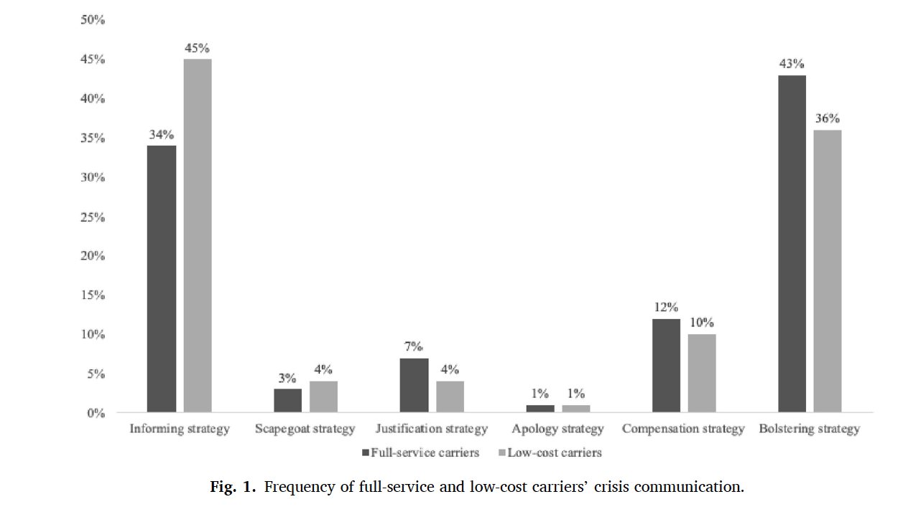
“ Building resilience in aviation:
The role of crisis management plan in a dynamic environment”
Crisis Communication
Source: Stephanie Scheiwiller, Laura Zizka, 2021

Slide 21
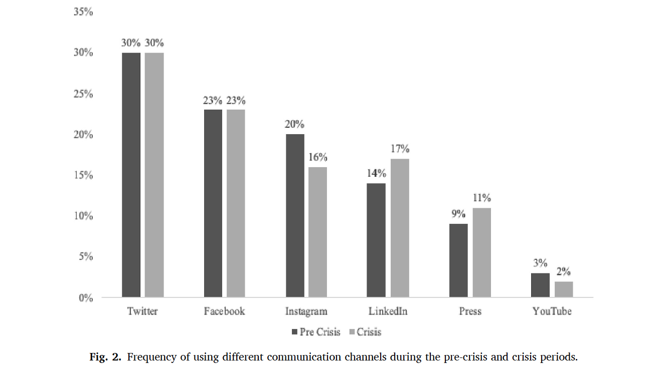
“ Building resilience in aviation:
The role of crisis management plan in a dynamic environment”
Crisis Communication
Source: Stephanie Scheiwiller, Laura Zizka, 2021

Slide 22
Devising ‘exit strategies’ to end the crisis
The current public health threat reopened the debate about the Schengen reform –EU transportation.
One of the lessons learned is that countries need to cooperate more effectively on early warning and risk assessment (Erzen et al., 2020).
In June 2020, the EP urged member states (in the Council) and the Commission to discuss a Recovery Plan for Schengen ‘in order to prevent temporary internal border controls from becoming semi-permanent in the medium term’ (European Parliament, 2020, p. 5).
What about Resilience?

Slide 23
“ Building resilience in aviation: The role of crisis management plan in a dynamic environment”
Resilience - System Restoration

Slide 24
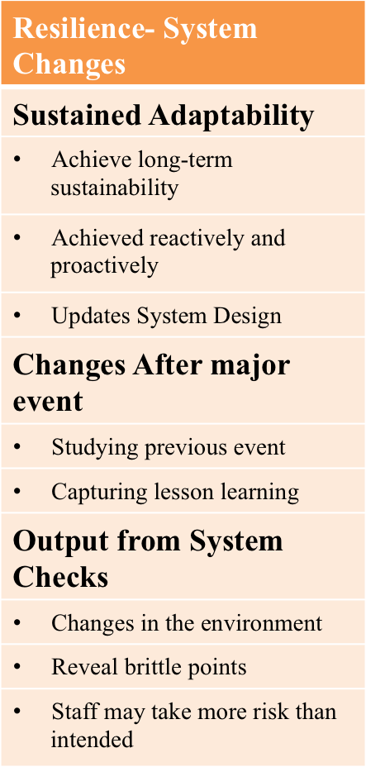
“ Building resilience in aviation: The role of crisis management plan in a dynamic environment”
Source: Adapted from Hollnagel, 2009

Slide 25
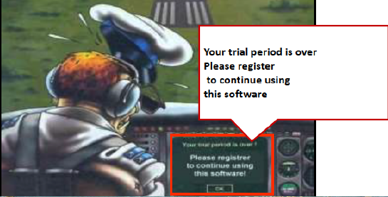
Questions & Answers

Slide 26
Dr. Dimitrios Ziakkas
Ph.D, MBA, MSc, BSc, FRAeS RAS / Retired Major HAF/ Captain TRI/TRE A-320/330/340/350
dziakkas@purdue.edu
/dimitrios-ziakkas-aa988317
/airfather

